Slide 1
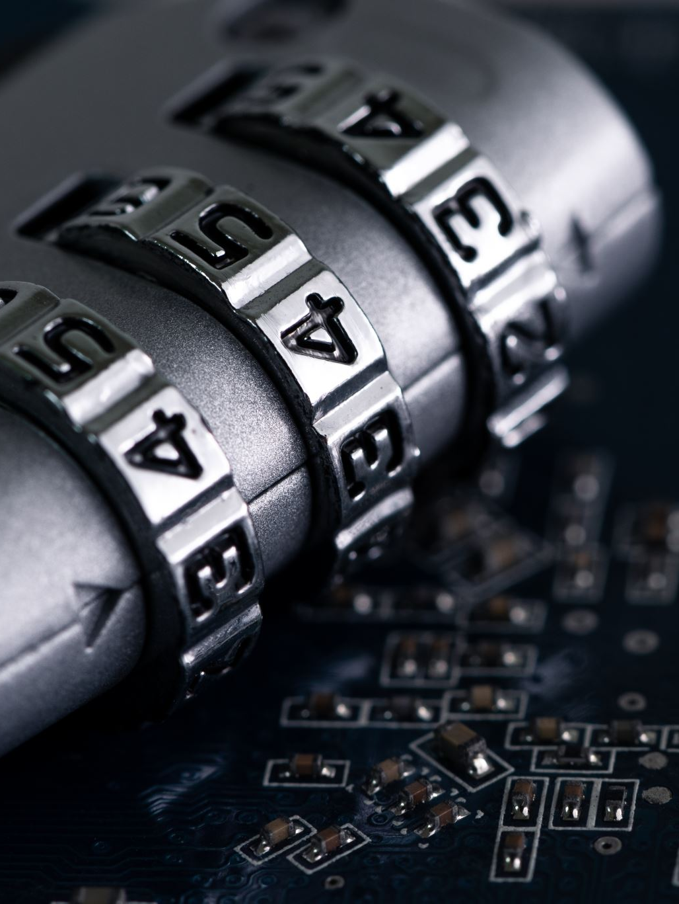
Introduction to Information Security Standards
ISO 27001/2022 IMPLEMENTATION

Slide 2
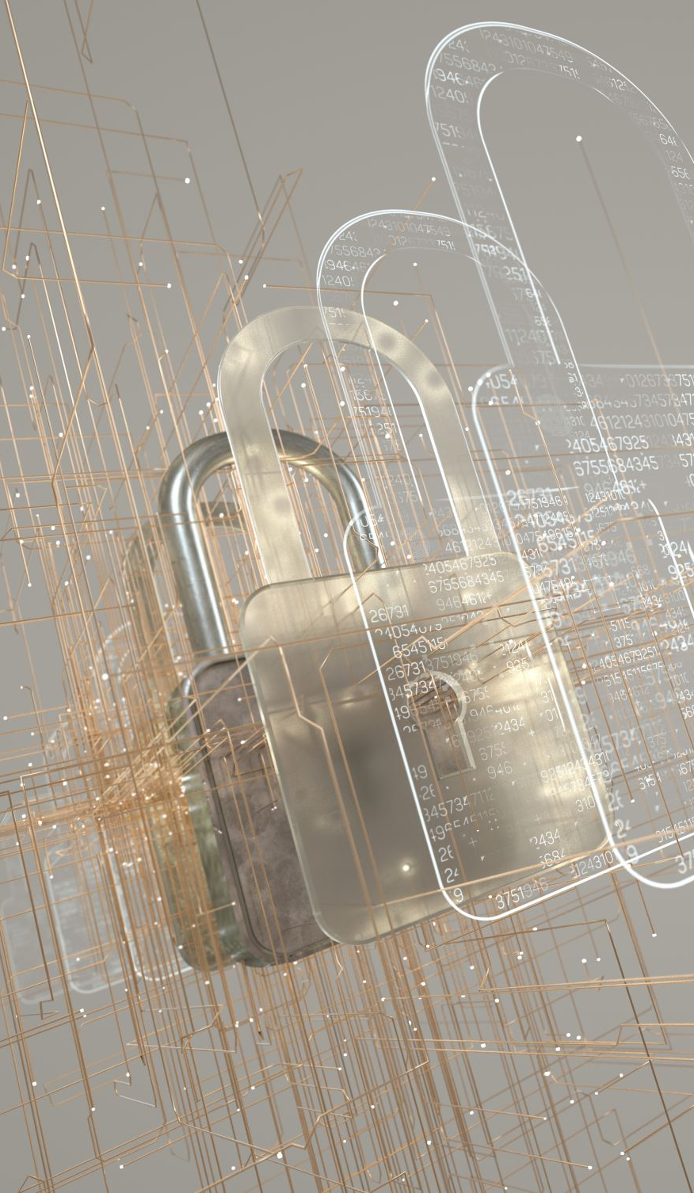
The Critical Role of Information Security
• Rise in cybersecurity threats (data breaches, ransomware, etc.)
• Regulatory compliance (GDPR, HIPAA, etc.)
• Protecting sensitive data (financial, healthcare, intellectual property)
• Ensuring business continuity and customer trust

Slide 3
Introduction to ISO 27001
• Definition of the standard
• Established by ISO and widely recognized globally
• Framework for managing information security risk
• Key objective: Confidentiality, Integrity, Availability (CIA Triad)
[Visual: Logo or diagram of the ISO framework]

Slide 4
Core Components of ISO 27001
• Security Policies: Organizational guidelines for data protection
• Risk Management: Identification, evaluation, and mitigation of risks
• Controls: Physical, technical, and administrative safeguards
• Compliance: Regular audits and certifications
[Visual: Diagram of the ISMS lifecycle]

Slide 5
Why Implement ISO 27001?
• Enhanced Security: Protect against data breaches
• Compliance: Meet legal and regulatory obligations
• Competitive Advantage: Build trust with clients and partners
• Cost Reduction: Minimize financial losses from cyber incidents
• Continuous Improvement: Adapt to new threats and technologies
[Visual: Icons showing benefits like cost reduction and compliance]

Slide 6
Barriers to Adopting ISO 27001
• Cost: Initial setup and ongoing maintenance
• Complexity: Involvement of multiple business units and processes
• Employee Resistance: Training and awareness efforts required
• Continuous Monitoring: Need for constant updates and audits
[Visual: Chart of common implementation challenges]

Slide 7
Final Thoughts and Next Steps
• Importance of adopting a structured approach to information security
• Start with understanding the core components of the standard
• Engage stakeholders and build a security-first culture
• Prepare for continuous assessment and improvement

Slide 8
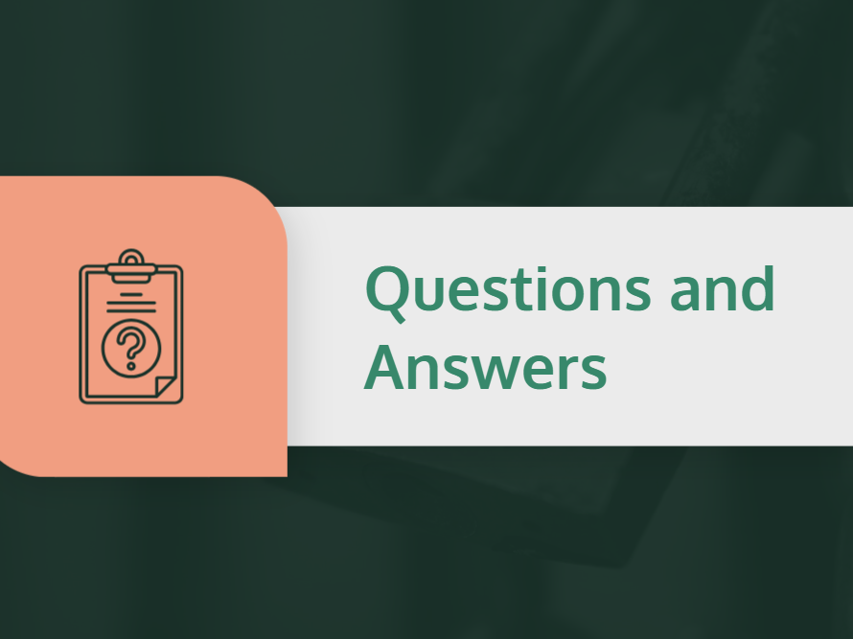

Slide 9


